Slide 1
Transfer Student Information
UCSB POLITICAL SCIENCE department

Slide 2
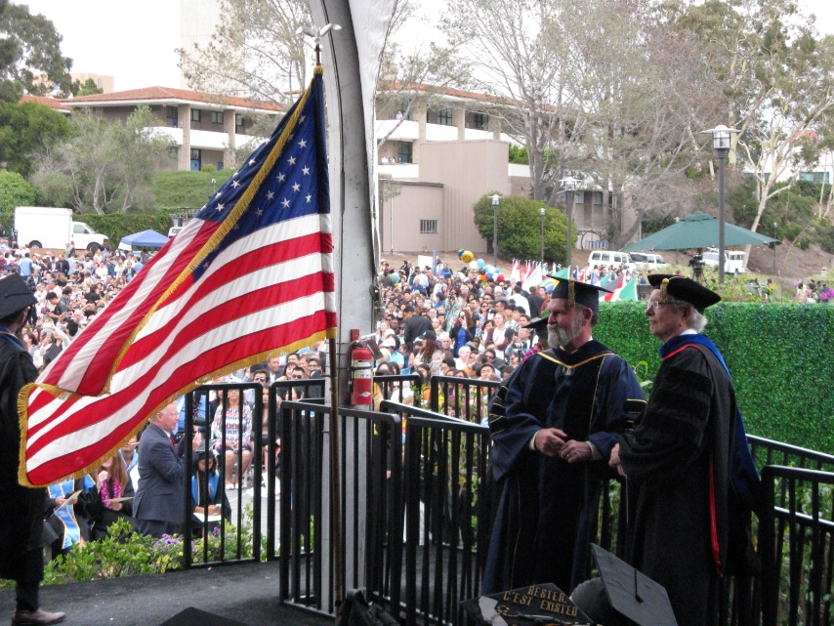
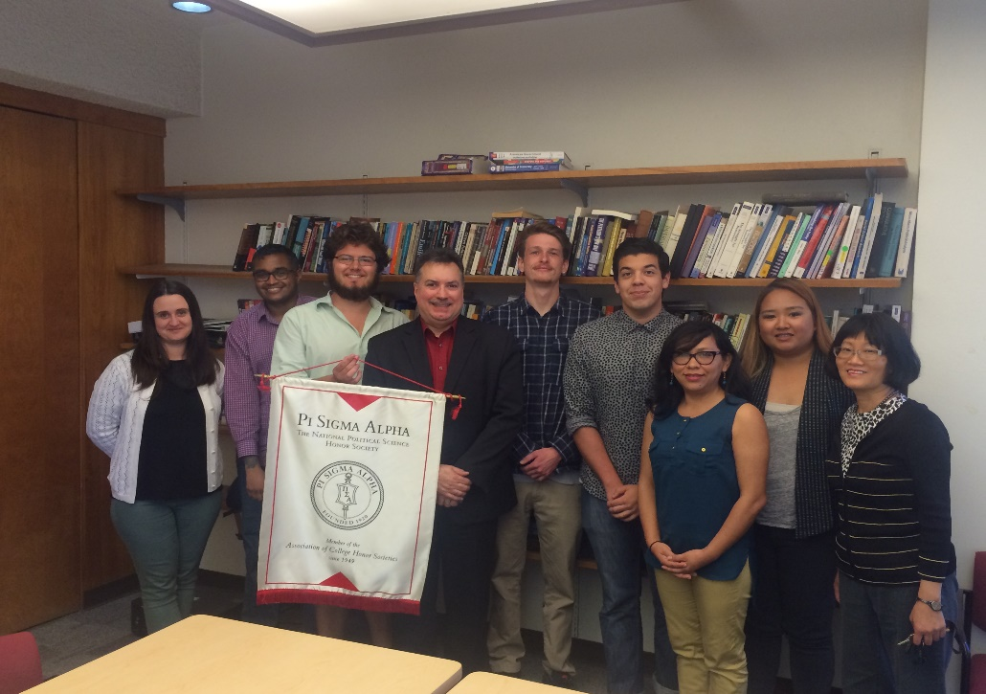
Welcome to Political Science!

Slide 3
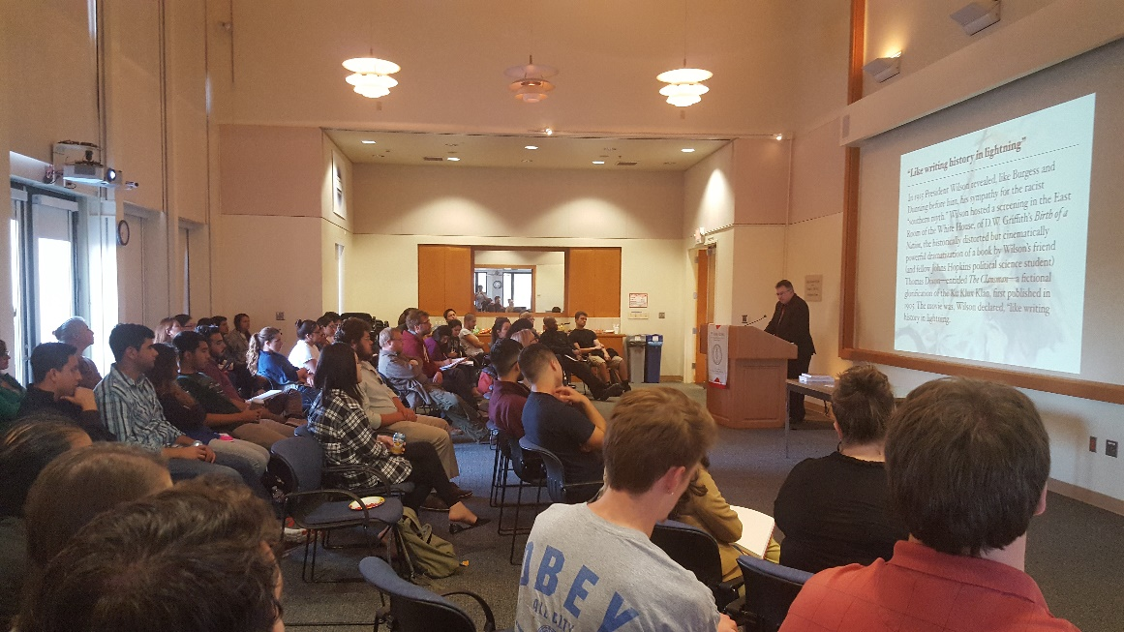
Who We are…
21 Political Scientists
50 Ph.D students
900 Majors and pre-majors
6 Full time staff

Slide 4
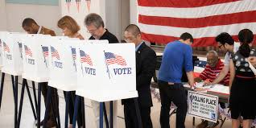
What we do…
Political scientists:
Teach
Work:
In government
For non-profits
For private companies
study:
governments
Politics
People

Slide 5
Subfields of political science
Political Theory (PT): Big questions about…democracy, representation, etc.
American politics (AP): The relationship between American government(s) and politics.

Slide 6
Subfields of political science
International relations (IR): How countries relate to other countries.
Comparative politics (CP): Studying how different countries handle government and politics.

Slide 7
Subfields of political science
Research methodology: How we actually do all of this studying.

Slide 8
What is a “Pre-Major”?
Transfers students (and newly admitted freshman) can ‘declare’ a political science major.
Means you’re part of our ‘team’!
Gets you priority registration during PASS 1
Doesn’t guarantee full major status for graduation

Slide 9
How do you become a “full” Major?
Take all five lower division prep courses:
PS 1 – Intro to Political Philosophy
Ps 6 - Intro to Comparative Politics
PS 7 - Intro to International Relations
PS 12 - Intro to American Politics
PS 15 - Intro to Research in Political Science
Complete the ECON 1 & 2 requirement
Earn a 2.6 GPA in the POLS prep you take here at UCSB!

Slide 10
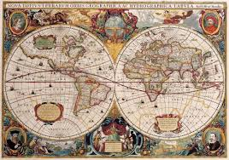
A Transfer Student’s Path to degree
180 Units total needed to finish your degree.
Transfer students can come in with a max of 105 units.
180 – 105 = 75 Units left – assuming transferred POLS units.

Slide 11
And the Path continues…
Political science requires completion of the following:
Lower Division Units: POLS 1, 6, 7, 12 & 15 = 21 units (Many transfer students come in with at least 4 to 8 transferred POLS units.)
40 Upper Division POLS units (CANNOT come from a community college)
total POLS Units required for a degree = 61

Slide 12
What the college requires…
College of Letters & Sciences requires 20 Upper Division NON-MAJOR elective units. [Meaning from other departments, like History or Global Studies]
Assuming a transfer student had zero POLS transfer work, but has completed the IGETC – that means they need to complete 61 POLS units + 20 non-major upper division units = 81 units.

Slide 13
Units required to graduate

Slide 14
What does the next two years look like?
First year: 12+16+16 = 44 units
Second year: 16+16+16 = 48 units
Total? 92!!!!! Meaning that it is very doable, since at the most you need only 81 units if you came in with a completed IGETC.
Most students need less than that total, depending on how many POLS prerequisites they transferred to UCSB.

Slide 15
Advancing to the full POLS major
Satisfying the lower division POLS courses + gpa (2.6 Or higher)
5 Core courses in a sub field
1 Course – each – in two other sub fields
3 Courses in any of the four sub fields
Could include:
4 Units of internship (P/NP)
4 Units of a senior seminar (POLS 196)
Or Just three UD POLS courses in any sub field

Slide 16
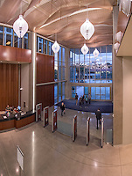
How best to accomplish that goal?
Make sure you have your transcripts sent to the Registrar.
Get good grades!
Go to class.
Do the assigned reading before each class.
Remember that for every hour in class, you should plan to study for 2 hours.

Slide 17
Other suggestions…
Use the department’s website as a tool.
Read all emails sent by the university, your department, your professors and teaching assistants.
Check in with our Facebook page.
Visit our peer advisors once every quarter.
Become aware of, and use, campus resources.

Slide 18
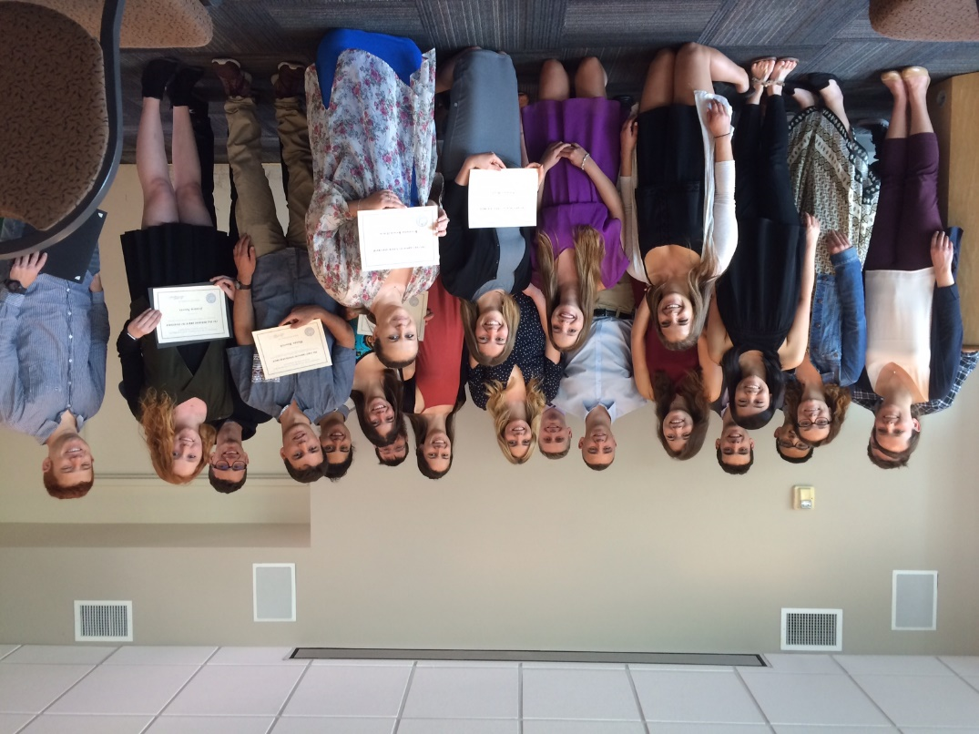
As Part of the POLS team:
You will have opportunities for:
Internships (with credit)
Study abroad program
U.C. Center in Washington, DC
Sacramento program
Research with professors
Honors program

Slide 19
Informational resources:
Department’s website: http://www.polsci.ucsb.edu/
Department’s Facebook page: https://www.facebook.com/PolSci.UCSB
College of Letters & Sciences advising: http://duels.ucsb.edu/advising
Department advising: http://www.polsci.ucsb.edu/undergrad/advising
Transfer Orientation on-line module: http://www.onlineorientation.net/ucsb

