Slide 1
THE INTERNATIONAL POLITICAL ECONOMY OF MONEY
Political Science 106MO
Winter 2019

Slide 2
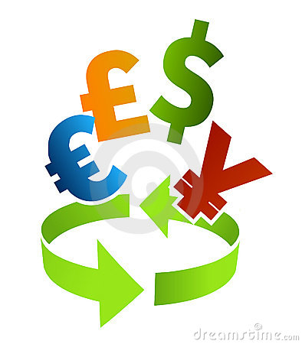
INTERNATIONAL MONEY - OVERVIEW
What is money?
What is international money?
What is the balance of payments? Why does it matter?
What choices does a government have when the balance of payments is in deficit?
What is the difference between fixed and floating exchange rates?
What is the “Unholy Trinity”?
What is the role of international liquidity?
What is meant by the problem of confidence?
What is an international monetary regime?
What international monetary regimes have existed in recent history?
What does the international monetary regime look like today?
What is the role of the US dollar in today’s international monetary regime?

Slide 3
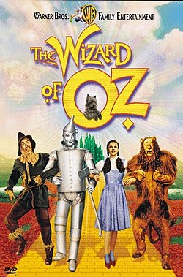
CLASSICAL GOLD STANDARD
What was the classical gold standard?
How did the gold standard come into existence?
How did the gold standard work?
Did the gold standard work well?
What were the “rules of the game”?
What is the difference between the gold standard and a bimetallic standard (bimetallism)?
What role did bimetallism play in late nineteenth-century American history?
What does “The Wizard of Oz” teach us (if anything) about monetary history?

Slide 4
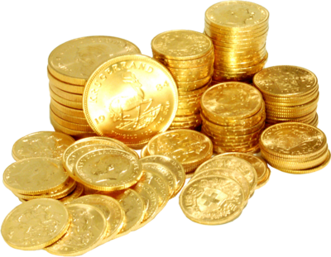
INTERWAR PERIOD
Why did the classical gold standard come to an end?
What was done to try to reconstruct the gold standard?
What was the significance of the Genoa Conference?
What is the difference between a gold standard and a gold-exchange standard?
Why did the reconstructed gold standard fail?
What is the theory of hegemonic stability?
What role did monetary blocs play after the collapse of the reconstructed gold standard?
What was the significance of the Tripartite Agreement?

Slide 5
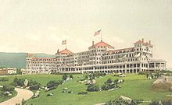
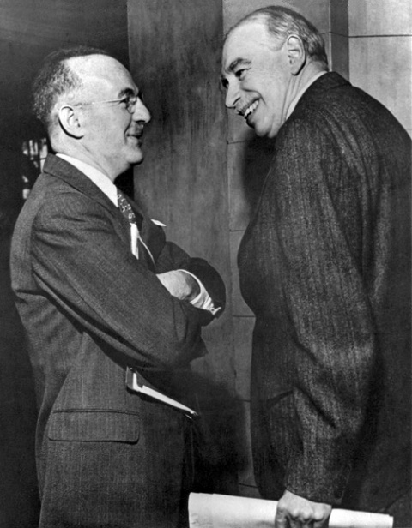
BRETTON WOODS
What was the Bretton Woods conference?
Why was the International Monetary Fund created?
What was the Bretton Woods system?
Why was it so difficult to sustain a system of “pegged but adjustable” exchange rates?
Why was the pound sterling so often in crisis?
What was the Triffin dilemma?
What was the Group of Ten?
Why were Special Drawing Rights (SDRs) created?
Why did the United States close the gold window in 1971?

Slide 6
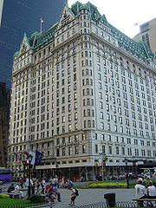
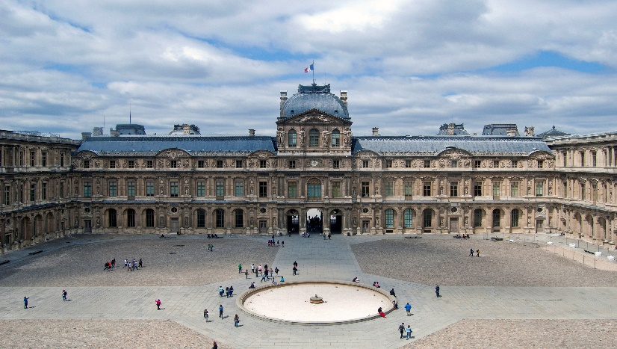
AFTER BRETTON WOODS
Did the Bretton Woods system die?
What are the problems of adjustment, liquidity, and confidence?
Why did so many currencies begin to float after 1971/73?
What was the significance of the Second Amendment to the Articles of Agreement of the IMF?
Why has IMF surveillance been so ineffective?
Where did the Group of 5 (now G-7) come from?
What were the Plaza and Louvre accords?
Why is the management of international liquidity so difficult today?
Who controls the growth of international liquidity?
What alternatives are there to today’s dollar?
How did the euro come into existence?
What is the Maastricht Treaty?
Is the emergence of rivals to the dollar desirable or undesirable?

Slide 7
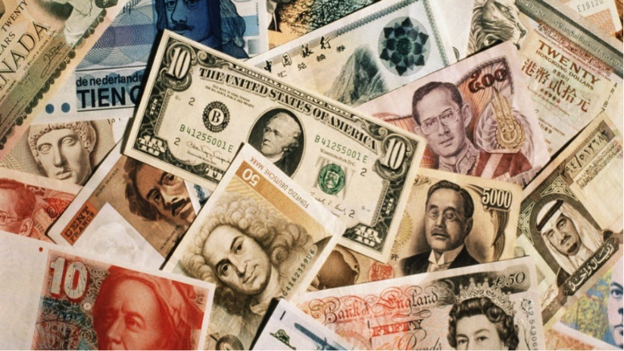
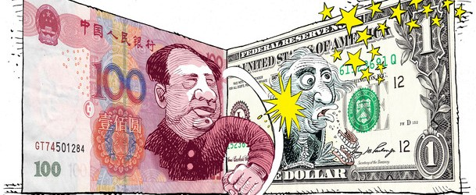
EXCHANGE RATES
What trade-offs do policy makers face in the choice of an exchange-rate regime?
What trade-offs do policy makers face in the choice of exchange-rate level?
Who benefits or loses from the choice of an exchange-rate regime?
Who benefits or loses from the choice of exchange-rate level?
What is the role of electoral considerations in exchange-rate policy making?
What is the effect of the Unholy Trinity in exchange-rate policy choice?
How serious is the risk of “currency war”?
Is the Federal Reserve fighting a currency war?
Is China fighting a currency war?
How effective is the exchange-rate “weapon”?

Slide 8
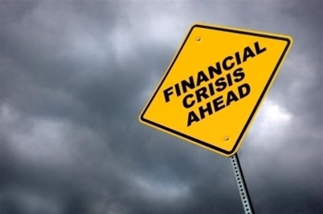
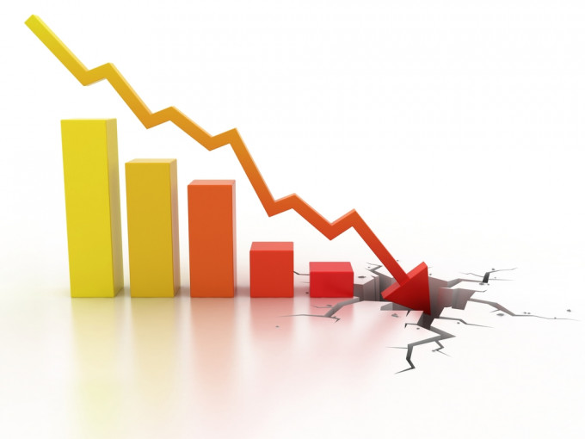
GLOBAL FINANCIAL MARKETS
What explains the globalization of financial markets?
What is the effect of financial globalization on economic policy making by governments?
What policy options do governments have to cope with globalized finance?
Are capital controls the solution?
Are financial crises inevitable?
Can financial crises be prevented?
Can financial crisis be effectively managed?
What caused the global financial crisis of 2008?
How effective were policy responses to the global financial crisis?
Have financial markets gone mad?

Slide 9


INTERNATIONAL MONETARY POWER
What is international monetary power?
How can international monetary power be exercised?
What are the limits of international monetary power?
Where does international monetary power come from?
What is the difference between monetary power and currency power?
What is the effect of currency power on general state power?
What is the effect of general state power on currency power?
What is the outlook for the dollar as an instrument of US policy?
What is the outlook for the Chinese RMB as an instrument of Chinese policy?

Slide 10
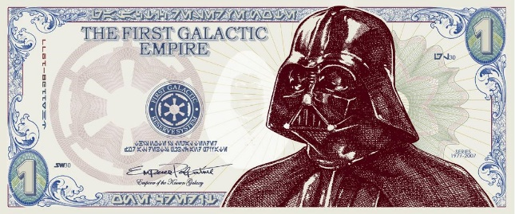
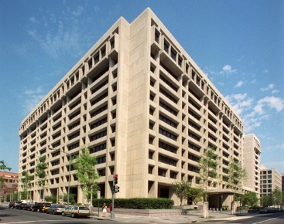
INTERNATIONAL MONETARY GOVERNANCE
What do we mean by governance?
Is governance of the international monetary system possible without a world government?
Can global financial markets govern themselves?
What is the role of the International Monetary Fund?
Who controls the IMF?
Can national governments collectively provide international governance?
What is the role of the G-7?
What is the role of the G-20?
Is it true that “the system worked” during and after the crisis of 2008?
Did the global financial crisis transform the international monetary system?
Has the power of the United States in the monetary system been eclipsed by China?
Has the crisis introduced “a new heterogeneity of thinking” about international monetary governance?

Slide 11
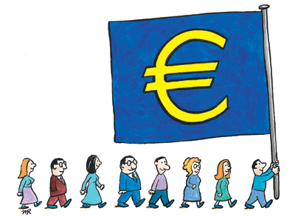
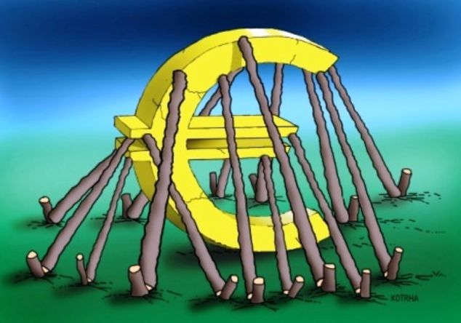
MONETARY REGIONALISM
What is monetary regionalism?
What is territorial money?
What is meant by the deterritorialization of money?
What policy choices are available to governments to cope with currency competition?
Is the number of territorial currencies fated to contract significantly?
What are the arguments for or against formal dollarization?
What are the arguments for or against a currency board?
What are the arguments for or against monetary union?
What do we learn from the experience of the euro?
Should the euro be regarded as a success or a failure?
What is the future of the euro?

Slide 12
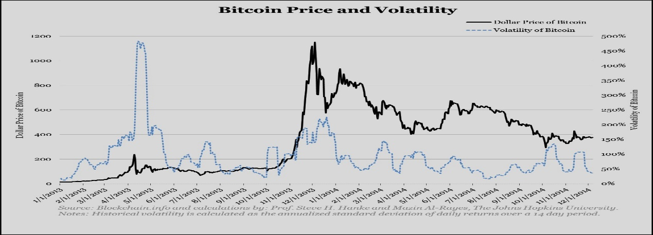
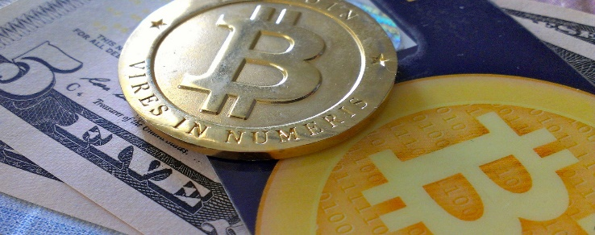
ALTERNATIVE MONEYS
What are “local currencies” (aka “community currencies”) and how do they work?
What are electronic currencies and how do they work?
Can the number of alternative moneys be expected to increase or decrease?
What are the implications of alternative moneys for traditional monetary policy?

Slide 13

FUTURE SCENARIOS
What are the centrifugal forces that threaten to pull the international monetary system apart?
What are the centripetal forces that help to hold the system together?
Can liberal multilateralism be strengthened?
Can fragmentation and conflict be avoided?
How realistic is “cooperative decentralization?”
Is “more of the same” (status quo) the default option?
Who will run the show?

